Slide 1


Cooking up a Literature Review, and the First Half of a Paper.
SSGC8807

Slide 2
The (now famous) Inverted Pyramids
Introduction – Phenomenon
Literature Review on Phenomenon. Research Gap
Data and Methods
Analysis 1, 2, 3
Summary/Conclusion – So what?

Slide 3
Our Interest
Introduction – Phenomenon
Literature Review on Phenomenon. Research Gap
Data and Methods
Analysis 1, 2, 3 – (next week)
Summary/Conclusion – So what?

Slide 4
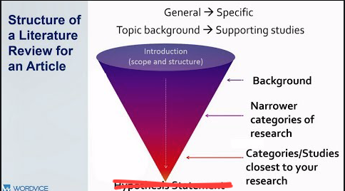
Understanding the purpose of the literature review
The first half of a research paper situates the research in the field it wishes to address and the areas it wants to contribute to in that field. It must do this quickly and efficiently. It must demonstrate knowledge of the field but also assumed knowledge of the audience. I.e., for this audience what can I assume they know already and so not have to cover in detail? This is the art of the literature review
The 4 working parts of a literature review.
The Phenomenon – new phenomenon not examined yet
The Methodology – Old or new methodology
Theory – Old or new theory
Summary – So what?

Slide 5






Some Ingredients and steps you need to cook up a Literature Review
Preparation. Cleaning the kitchen
Base Literature – foundational studies of the phenomenon – what is the style of the dish?
Topical Studies– specific ingredients
Fresh ingredients – latest research
Herbs and Spices – (or drive by references) - ingredients that lift the flavors of the cooking

Slide 6
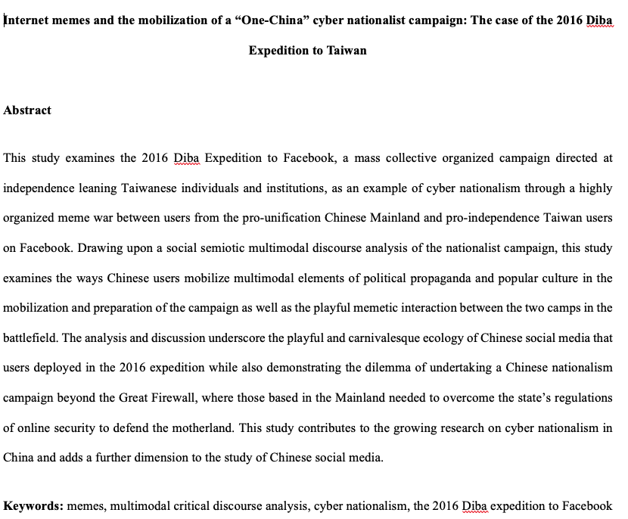
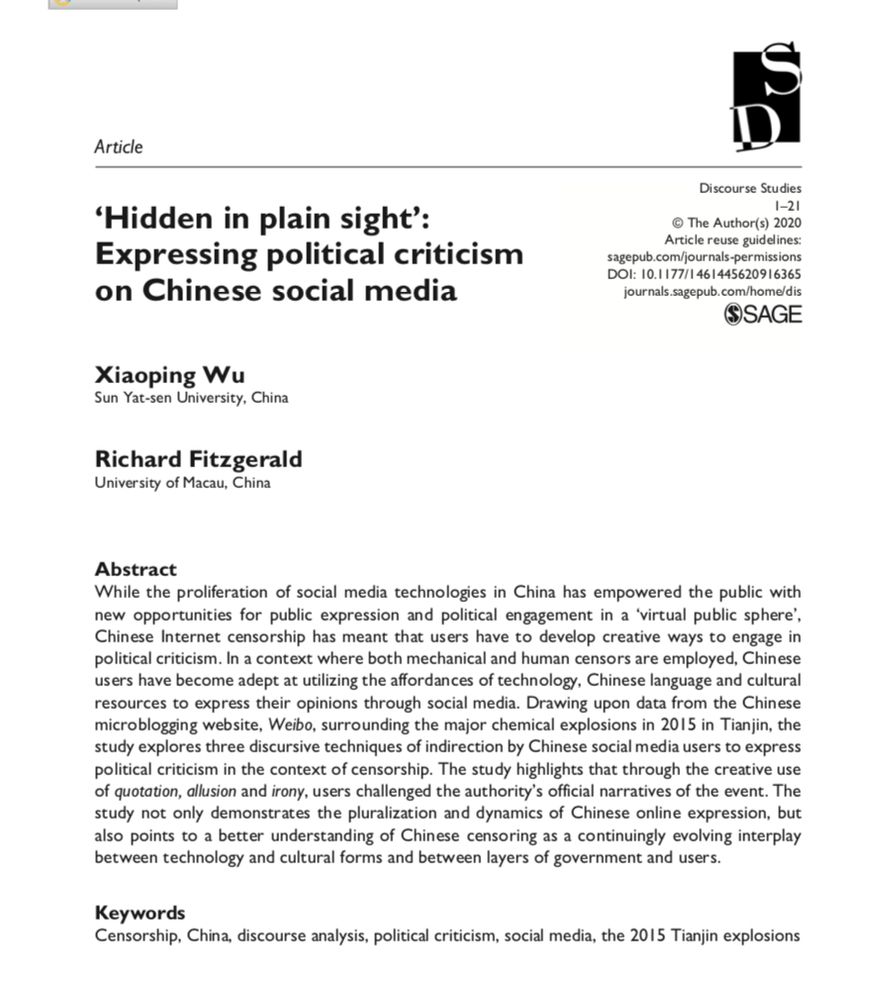
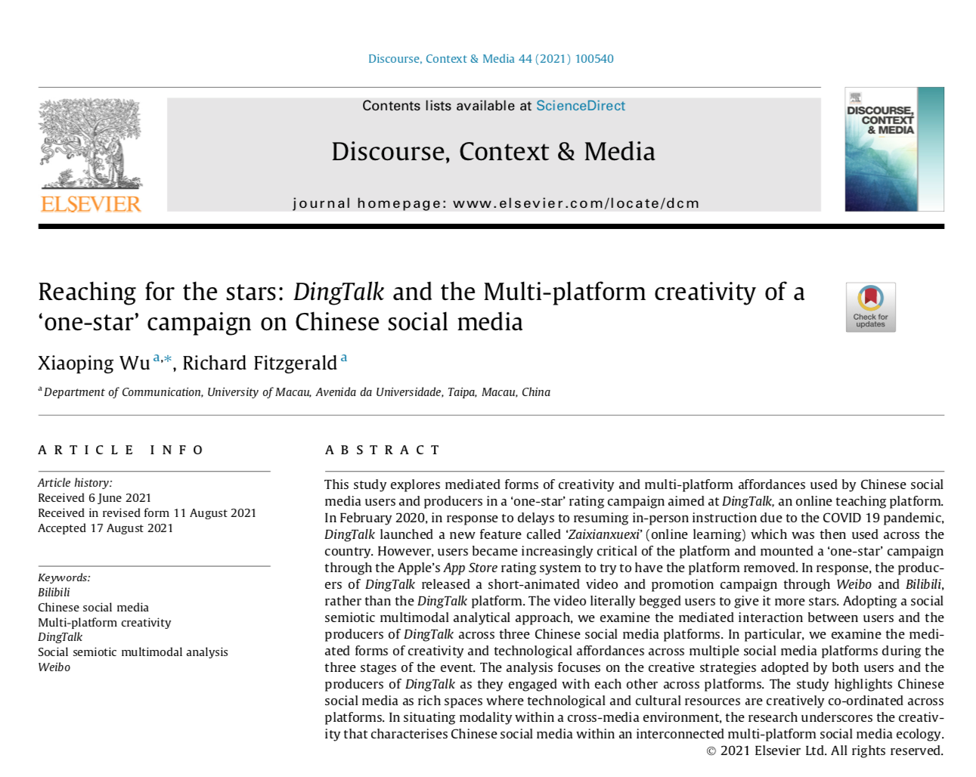


Abstracts

Slide 7
Abstract by the Numbers
1. This study explores mediated forms of creativity and multi-platform affordances used by Chinese social media users and producers in a ‘one-star’ rating campaign aimed at DingTalk, an online teaching platform.
In February 2020, in response to delays to resuming in-person instruction due to the COVID 19 pandemic, DingTalk launched a new feature called ‘Zaixianxuexi’ (online learning) which was then used across the country. However, users became increasingly critical of the platform and mounted a ‘one-star’ campaign through the Apple’s App Store rating system to try to have the platform removed. In response, the produc-ers of DingTalk released a short-animated video and promotion campaign through Weibo and Bilibili, rather than the DingTalk platform. The video literally begged users to give it more stars.
Adopting a social semiotic multimodal analytical approach, we examine the mediated interaction between users and the producers of DingTalk across three Chinese social media platforms.
In particular, we examine the mediated forms of creativity and technological affordances across multiple social media platforms during the three stages of the event.
The analysis focuses on the creative strategies adopted by both users and the producers of DingTalk as they engaged with each other across platforms. The study highlights Chinese social media as rich spaces where technological and cultural resources are creatively co-ordinated across platforms.
In situating modality within a cross-media environment, the research underscores the creativity that characterises Chinese social media within an interconnected multi-platform social media ecology.

Slide 8
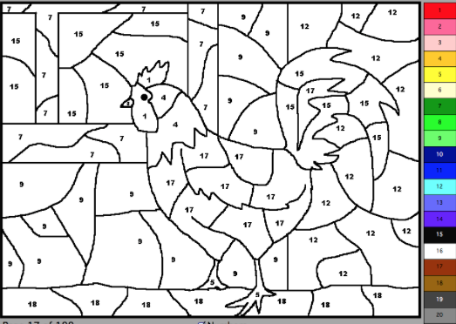
Abstract. Painting by Numbers
This study examines the 2016 Diba Expedition to Facebook, a mass collective organized campaign directed at independence leaning Taiwanese individuals and institutions, as an example of cyber nationalism through a highly organized meme war between users from the Chinese Mainland and Taiwan on Facebook.
Drawing upon a multimodal critical discourse analysis of the nationalist campaign, this study examines the ways Chinese users mobilize multimodal elements of political propaganda and popular culture in the mobilization and preparation of the campaign as well as and the playful memetic interaction between the Mainland and Taiwan in the battlefield.
The analysis and discussion underscore the playful and carnivalesque environment of Chinese social media users displayed in the 2016 expedition while also demonstrating the dilemma of undertaking a Chinese nationalism campaign beyond the Great Firewall where users needed to violate the state’s regulations of online security to defend the motherland.
This study contributes to the growing area of cyber nationalism in China and also provides methodological implications to studying Chinese social media data through a lens of multimodal critical approach.
Keywords: memes, multimodal critical discourse analysis, cyber nationalism, the 2016 Diba expedition

Slide 9
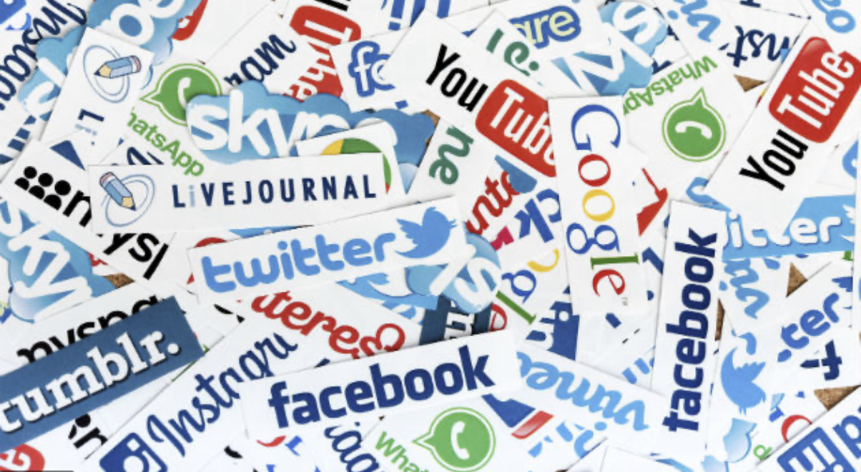
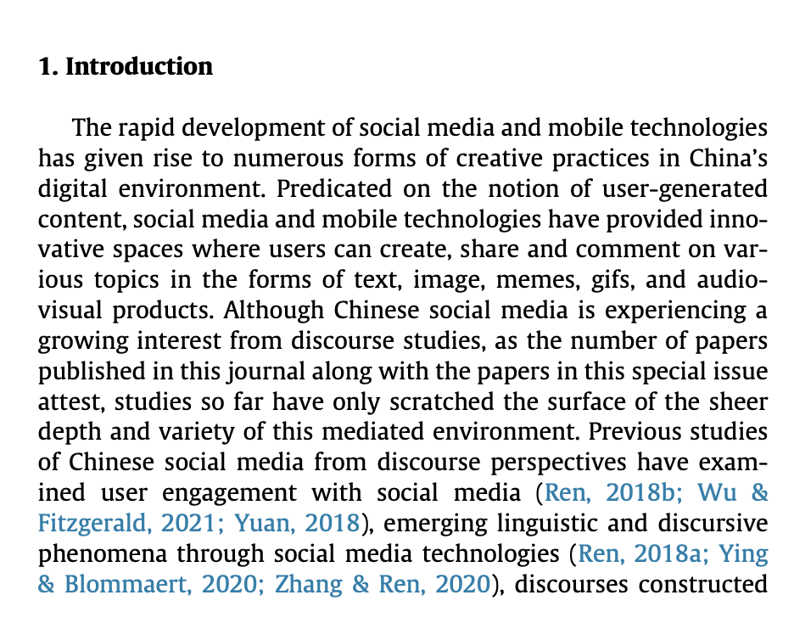
Omg! Social Media is huuuuge – closing the topic down, and getting to our point of departure

Slide 10

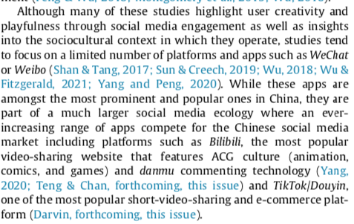
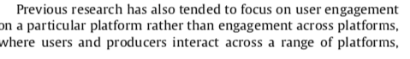
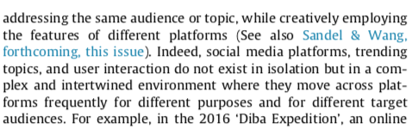
1 Preparation Wiping down the surfaces. (Make sure you wear gloves)

Slide 11
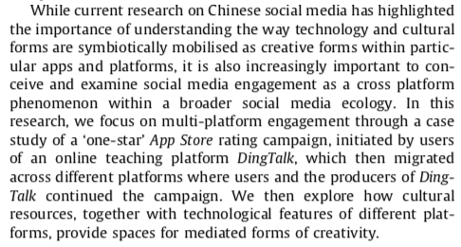

Slide 12
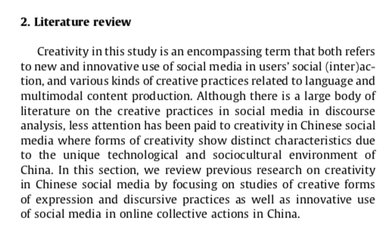
Today we will be cooking this Recipe

Slide 13
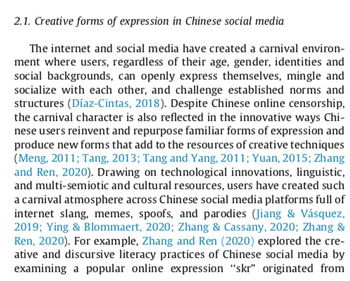
Base Ingredients Foundational Studies 1

Slide 14
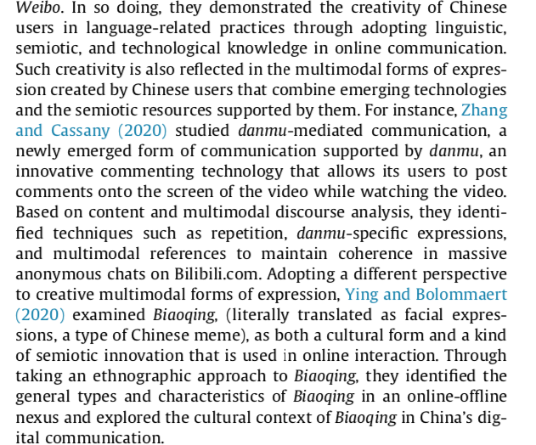
Fresh Ingredients Specific Topic Studies 2

Slide 15

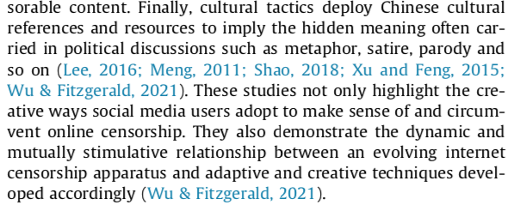

Adding some seasoning, doing a selfie

Slide 16
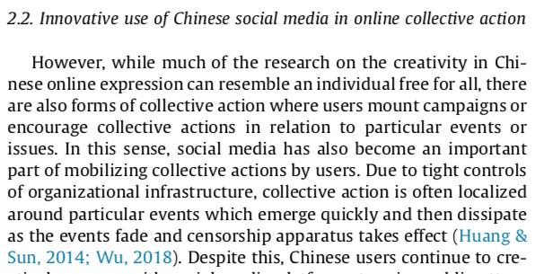
Blending. Topic Studies 2.

Slide 17
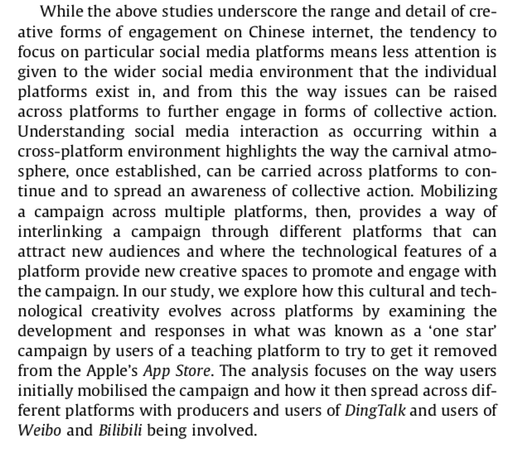
Fresh ingredients plus Herbs and Spices

Slide 18


The Phenomenon and the Claim
Is this adding one new ingredient to a dish or making a new dish?
Is it adding one more brick in the wall or starting a new wall?

Slide 19
Methodology
Off the shelf, new, or new configuration?
Is the analysis applying an already formed approach?
Is the analysis introducing a new approach?
Is the analysis a technical demonstration of an approach?
Is the analysis demonstrating the usefulness of an approach for this kind of data/analysis.
Is the methodology drawing on different approaches for this particular analysis?

Slide 20

Off-the-Shelf Methodology Or following the Recipe
Is it using an ‘off the shelf’ methodology? The methodology exists prior to the analysis and is simply applied to the data.
Data in – tweek the variables - results out – significance, P factor.
Data in – transforms the data into something relevant to the methodology – findings come out – confirming the approach.

Slide 21

Designing a Methodology
Designing or assembling a methodology.
Methodology is designed for the data – not the other way around.
Each new analysis requires a new assemblage of methods
“draw on”

Slide 22
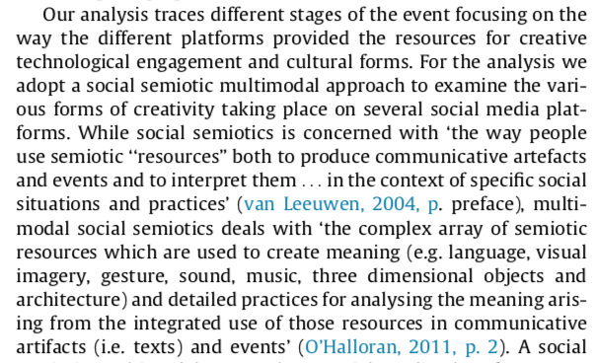
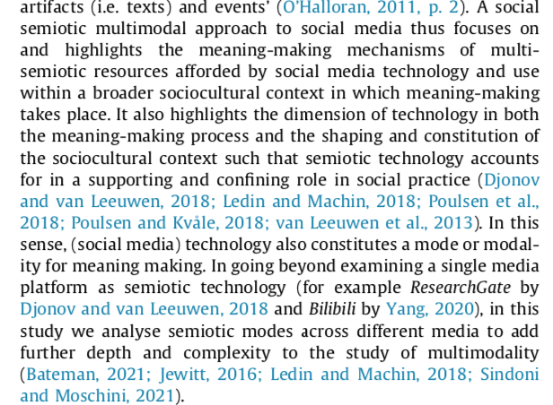
Origin
Main People, Current
Main people in SSMM
Methodology Contribution

Slide 23
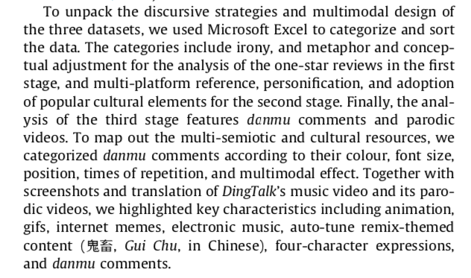
End of the first half. The three stages of the things to come

Slide 24
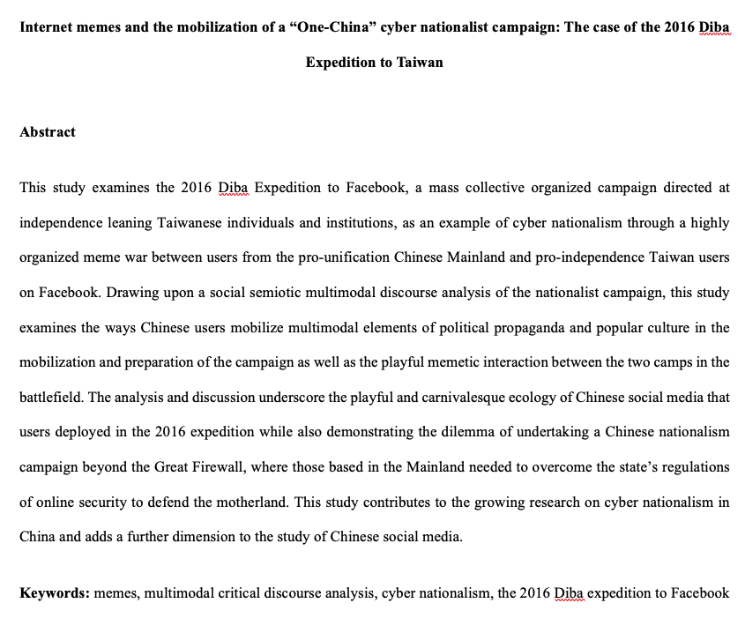
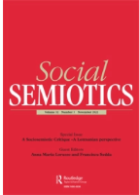
To be published in Social Semiotics 2023.

Slide 25
The why
Although previous studies have noted the importance of internet and social media technologies in facilitating nationalism and the innovative forms of nationalist expression brought by them (see Fang and Repnikova, 2018; Han, 2019; Qiu, 2015; Wu, 2007; Yang, 2019; Zhou and Miao, 2019), less attention has been paid to the way in which nationalist discourses are constructed and mobilized through digital technologies, popular culture, and multimodal semiotic resources within the context of online censorship. This is an underexplored yet important topic as it operates within a technologically mediated multimodal discursive arena that offers further understanding of contemporary forms of online nationalism within the Chinese social media environment that is playful, creative and carnivalesque and which is also subject to a pervasive and multidimensional censorship system (Author removed). In this paper we turn our attention to this aspect of cyber nationalism and examine a Chinese online nationalist campaign organized across social media platforms targeting Taiwan.

Slide 26
Previous Studies 1. Chinese nationalism and cyber nationalism
While nationalism has played a significant role in shaping China’s political environment and public discourse this has become more visible in recent years due to government encouragement and support. Under President Xi Jinping Chinese nationalism has become ever more central in Chinese daily life through explicit political and social policies and is now embedded in Chinese education through patriotic education campaigns (Chen et al., 2020). Moreover, as reflected in the patriotic education campaign, the state government promotes nationalism in a way that tries to “conflate ‘love’ ﻿for the state with the ‘love’ for the Communist Party of China” (Chen et al., 2020, 6). In contrast to government organised campaigns promoting nationalism and nationalist policies, Chinese cyber nationalism is described as “a non-government sponsored ideology and movement that has originated, existed, and developed in China’s online sphere” (Wu, 2007). Meanwhile, scholars have also acknowledged that although cyber nationalism is rarely sponsored by the government, the government has always been monitoring and sometimes intervening in Chinese cyber nationalist movements through various ways (Schneider, 2018a; Wu, 2007). Taking advantage of the internet and associated technologies, Chinese cyber nationalists make use of the digital space to express their nationalist sentiments and organize nationalist movements on political and social issues related to China. Broadly speaking, Chinese cyber nationalism mounted by internet users is a spontaneous, grassroots, and bottom-up form of nationalism (Chen et al., 2020) nurtured, supported and shaped by digital technologies. For example, during the early stage of the outbreak of the COVID-19, in response to politicians and news organizations outside China blaming China for the virus and calling the virus the “Chinese virus”, Chinese nationalists flooded the social media pages of the politicians and news agencies outside China to counter those claims and express their support and love for China.

Slide 27
2. Internet memes as political participation and mobilization
Along with much social media engagement in China, the discourse of political events and cyber nationalism is often mobilized through the use of memes that convey irony, parody, playfulness, and creativity (Chen et al., 2020; Liu, 2019; Yang, 2019, Author removed, 2021a). Similar to Dawkin’s (2006/1976) original idea of a unit of cultural knowledge that spreads through replication or imitation, an internet meme has distinct characteristics due to the digital environment and culture in which it is created and used (Shifman, 2014). Internet memes can take various forms including words, images, videos and Gifs that draw upon various cultural and semiotic resources and share common characteristics of content, form, or stance with an awareness of itself as a culturally loaded vehicle within an ecology of related memes that are both context-free and context-sensitive (Shifman, 2014). They are adapted and transformed and circulated in relation to particular situations to generate context-sensitive meaning. For our analysis, we examine internet memes as part of socially constructed public discourses that combine ﻿technological, cultural, and social resources in producing, replicating, and sharing memes for the purpose of political mobilization and participation (Author removed, 2021a). Previous research has noted the role of memes in social and political movements. For instance, Milner (2012) argues that internet memes have become a new form of political participation that allows different voices to be heard and discussed, while Shifman (2014) discusses three interwoven functions of internet political memes: memes as forms of persuasion or political advocacy, m﻿emes as grassroots action, and memes as modes of expression and public discussion (Mina, 2014, Rentschler and Thrift, 2015; Liang, 2017; Unuabonah and Oyebode 2021; Schneider, 2021).

Slide 28
Cont’
Within the research on political memes and political mobilization, a focus on memes and Chinese digital nationalism has been growing in recent years. For example, Chen et al. (2020) studied the construction of playful patriotism and promotion of ﻿the Chinese state’s political agenda through memetic short videos with the hashtag “positive energy” on Douyin, ﻿the original Chinese short-video application of the Tik Tok app, whereas Schneider (2021a) examined how Chinese state leadership constructed the Chinese nation through memes to legitimize itself and promote unity and solidarity during the COVID-19 pandemic. The use of internet memes being weaponised to mobilize Chinese cyber nationalism has also been examined in relation to the 2016 Diba Expedition examined here, where it was described as a meme war (biaoqingbao dazhan) (Liu, 2019b, Zhou and Miao 2019). In this previous research Zhou and Miao (2019) used an ethnographic approach to explore how participants from the Mainland and Taiwan made use of memes to construct contesting narratives about the event, while Guo and Yang (2019) combined text analysis and interviews to examine the strategies and effects of the memetic communication and consensus mobilization in the same event. What is clear from previous research is that while ostensibly playful, internet memes can become powerful tools within political discourse through conveying condensed and socially pointed meaning in both their particular instances and the creative environment of social media (Guo and Yang, 2019; Mina, 2014). However, although previous research, including research on the 2016 Diba Expedition, has noted the use of weaponised memes, little attention has been paid to the detailed analysis of the creative ways in which participants drew on political resources and popular culture together with multimodal and technological resources in creating different types of memes themed around a “One China” discourse, and how these memes were deployed in the “expedition” to Taiwan. By focusing on the detailed ways in which memes were constructed and used, this study aims to contribute to understanding the way internet memes can be used as powerful weapons in mobilizing nationalist campaigns and constructing nationalist discourses.

Slide 29
2. Methodology
Brick in the Wall or New Innovation?

Slide 30
Data and Methods
The data collected for this study consists of screenshots of memes and texts circulated among the expedition participants on QQ, and comments and responses left on the Facebook pages of President Tsai Ing-wen, Set News, and The Liberty Times between 7pm on January 20 and Midnight of January 21, 2016. Using the Chinese data mining software “bazhaoyu caijiqi” (Octopus collector), we collected 45,491 comments and responses including 19,866 comments and responses from Set News Facebook page, 4,500 comments and responses from President Tsai’s webpage, and 21,125 comments and responses from The Liberty Times. For a detailed multimodal discourse analysis, we selected 1,500 comments (500 from each Facebook page). For the analysis we adopt a multimodal critical discourse analysis (MCDA) (Machin and Mayr, 2021) and multimodal discourse analysis (MDA) (Ledin and Machin, 2018) to examine three main layers of the campaign.
In the first layer of analysis, we focus on the “weapon” manufacturing and examine three types of memes Chinese mainland users prepared for the expedition. In the second layer of analysis, we explore the multimodal nationalist discourse constructed by those internet memes. The third layer of analysis then focuses on the detailed examination of how mainland users engaged with Taiwan users on the battlefield .

Slide 31

ANALYSIS

Slide 32
The ‘so what?’
Discussion and conclusion
The above study focused on the 2016 Diba expedition to Taiwan as a form of cyber nationalism. The analysis demonstrated how mainland users mobilized human, technological, cultural, and multimodal recourses to create and deploy “weapons” for the expedition. Through the creation of banks or collections of prefabricated memes as “weapons” the Diba Expedition created an “imagined community” (Anderson, 2006) where participants were united through a collaboratively created discourse of nationalism and the enjoined collective goal of defending the “One-China” policy through attacking the pro-independence of Taiwan. This form of nationalism was then mobilized through a popular form of Chinese meme, biaoqingbao, that draws upon popular culture purposed for nationalist statements, making it creative and humorous for engaging with the pro-Taiwan independence online.

Slide 33
2
It is of course not without irony that this nationalist campaign took place in the context of Chinese online censorship that blocks foreign websites such as Facebook, Twitter, and Google. Under such circumstance, mainland users needed to use technologies such as VPNs to circumvent censorship and get to the battlefield of Facebook. Moreover, Chinese online censorship also bans discussion of politically sensitive topics in online communication in the Mainland. Thus, on the one hand Chinese mainland users sought to fight against the pro-independence of Taiwan to safeguard the unity of the national territory, while on the other hand, they had to do it through circumventing the state government because this campaign broke China’s online security rules and regulations. In this way, the campaign was considered a patriotic movement without the blessing from the government (Han, 2019) while the mainstream official media approved the campaign and believed that it was a kind of cross-strait cultural communication and an online carnival between the young generation of both sides (“社评：不必夸张‘帝吧出征’的两岸负效果 [Editorial: There is no need to exaggerate the negative effect of the cross-strait Diba expedition],” 2016).

Slide 34
3
While it is debatable as to the effectiveness of the expedition, the 2016 Diba Expedition did offer a new pattern of Chinese cyber nationalism characterized by the mobilization of multiple social media platforms and playful and humorous characters. Since 2016, the model has been copied several times, such as flooding the Facebook page of ﻿Virgin Atlantic, a British airline, due to its alleged racism against a Chinese female passenger in March, 2016, as well as the 2019 Diba expedition to Hong Kong, to fight against the pro-democratic movements. However, some expeditions were more successful than others. For example, the Diba expedition to Virgin Atlantic was a successful one as Virgin Atlantic apologized for its mistake in a short while. However, when mainland users tried to copy the Taiwan expedition for a 2019 Diba Expedition to Hong Kong, it was ended quickly because users from the pro-democratic movements in Hong Kong fought back by hacking the social media accounts of the leaders and participants of the expedition and revealing their private information ranging from their ID card numbers to their bank information. To protect their privacy, the 2019 Diba Expedition to Hong Kong was halted shortly after it began.

Slide 35
4
While it is debatable as to the effectiveness of the expedition, the 2016 Diba Expedition did offer a new pattern of Chinese cyber nationalism characterized by the mobilization of multiple social media platforms and playful and humorous characters. Since 2016, the model has been copied several times, such as flooding the Facebook page of ﻿Virgin Atlantic, a British airline, due to its alleged racism against a Chinese female passenger in March, 2016, as well as the 2019 Diba expedition to Hong Kong, to fight against the pro-democratic movements. However, some expeditions were more successful than others. For example, the Diba expedition to Virgin Atlantic was a successful one as Virgin Atlantic apologized for its mistake in a short while. However, when mainland users tried to copy the Taiwan expedition for a 2019 Diba Expedition to Hong Kong, it was ended quickly because users from the pro-democratic movements in Hong Kong fought back by hacking the social media accounts of the leaders and participants of the expedition and revealing their private information ranging from their ID card numbers to their bank information. To protect their privacy, the 2019 Diba Expedition to Hong Kong was halted shortly after it began.

Slide 36
5
Finally, with the increasing interest in the innovative and evolving forms of cyber nationalism facilitated by rapid developments in social media technologies, research from the perspective of multimodal discourse analysis and critical discourse analysis remains an important but underdeveloped area. Based on the analysis of the organisation and mobilization of cyber nationalist event and the manufacture and use of pre prepared nationalist memes this study contributes to highlighting the playful, creative and carnivalesque characteristics of new forms of nationalist movements in China. At the same time the research also highlights the complex digital media ecology of control and censorship that manifests in innovation and creative responses within a layered and constantly shifting environment (Wu and Fitzgerald 2021). Finally, through a multimodal analysis of the nationalist campaign the research also draws attention to the ways in which the Chinese digital environment continues to provide a rich source and an analytic challenge forms of discourse analysis (Fitzgerald, Sandel and Wu, 2022).

Slide 37
Assignment 2 (50%)
Crafting the Literature Review
Individual Assignment total up to 1500 words. (No more)
Two parts to the assignment.
Part 1. up to 750 words. Using the research paper from your supervisor, or a new one also from your supervisor, critically examine the first part of the paper up until the analysis sections.
Focus on examining the set up of the paper, around Phenomenon, Methodology and Theory (if present). What the paper is doing, why it is doing it and how is it doing it. Also consider the ‘so what’ of the paper, how does it reconnect with the literature in the final summary/conclusion.
Part 2. Produce a 750 word literature review on a topic/phenomenon of your choice.

